Slide 1
Banking Credit System
zzzz
zzzzzzz

Slide 2
Contents
1
Introduction
2
Development process
3
Demo
4
Q&A

Slide 3
Project management
Quality Assurance
Result
Introduction
Long làm
10m
Group
Presentation style
Business context
Plan
Development process
Requirement
Design
Implement
Testing
Demo
Q&A

Slide 4
Project management
Quality Assurance
Result
Introduction
Role, responsibility, time table
Giang
5m
Group
Project
Business context
Plan
Development process
Requirement
Design
Implement
Testing
Demo
Q&A

Slide 5
Project management
Quality Assurance
Result
Introduction
Ly, 10m
- Chỉ ra mỗi ng làm 1 phần (có thể dùng matrix table),
review, chỉ ra hoạt động review,
Template
3 phiên bản requirement (t Việt, t Anh, bản Doc cho report 3)
tìm hiểu nghiệp vụ
Group
Project
Business context
Plan
Development process
Requirement
Design
Implement
Testing
Demo
Q&A

Slide 6
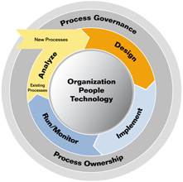
Project management
Quality Assurance
Result
Introduction
Group
Project
Business context
Plan
Development process
Requirement
Design
Implement
Testing
Demo
Q&A

Slide 7
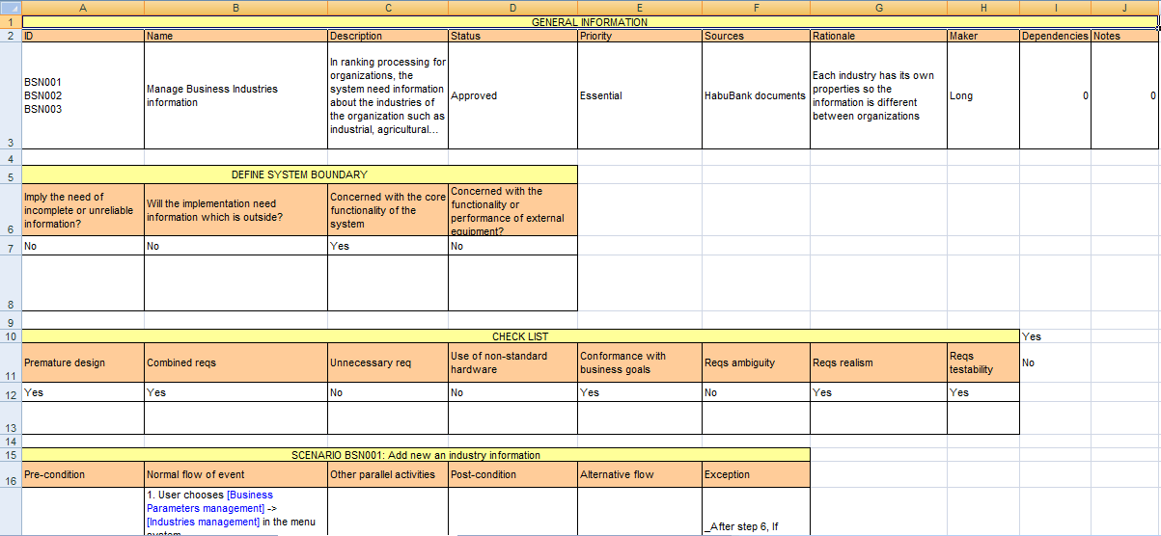
Project management
Quality Assurance
Result
Introduction
Group
Template
Project
Business context
Plan
Development process
Requirement
Design
Implement
Testing
Demo
Q&A

Slide 8
Project management
Quality Assurance
Result
Introduction
Review action:
Review within sub-team.
Cross-review of two sub-team
Customers clarification.
Group
Project
Business context
Plan
Development process
Requirement
Design
Implement
Testing
Demo
Q&A

Slide 9
Project management
Quality Assurance
Result
Introduction
Result:
FUNCTIONAL REQUIREMENT
Use cases:
22 BSN use cases
33 INV use cases
14 NFI use cases
9 FI use cases
24 SYS use cases
17 RNK Use cases
2 RPT use cases
Group
Project
Business context
Plan
Development process
Requirement
Design
Implement
Testing
Demo
Q&A

Slide 10
Project management
Quality Assurance
Result
Introduction
NON FUNCTIONAL
Reliability
Security
Portability
Performance
Group
Project
Business context
Plan
Development process
Requirement
Design
Implement
Testing
Demo
Q&A

Slide 11
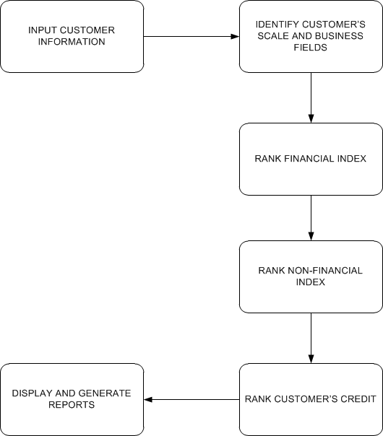
Project management
Quality Assurance
Result
Introduction
DOMAIN REQUIREMENT
Group
Project
Business context
Plan
Development process
Requirement
Design
Implement
Testing
Demo
Q&A

Slide 12
Project management
Quality Assurance
Result
Introduction
BSN: Business parameter management:
Manage Parameter for ranking business Industry
Industry
Scale
Business Types
… etc
NFI, FI: manage index for Financial and non-financial index
Parent and child index
Numeric and character index
Proportion
Score.
Group
Project
Business context
Plan
Development process
Requirement
Design
Implement
Testing
Demo
Q&A

Slide 13
Project management
Quality Assurance
Result
Introduction
INV: Individual parameter management:
Manage Parameter for ranking individual
Basic and collateral index
Loan term, purposes etc…
Group
Project
Business context
Plan
Development process
Requirement
Design
Implement
Testing
Demo
Q&A

Slide 14
Project management
Quality Assurance
Result
Introduction
INV: Individual parameter management:
Manage Parameter for ranking individual
Basic and collateral index
Loan term, purposes etc…
Group
Project
Business context
Plan
Development process
Requirement
Design
Implement
Testing
Demo
Q&A

Slide 15
Project management
Quality Assurance
Result
Introduction
Ranking for customers.
Business customers:
General Info
Scale
Financial
Non-Financial
Ranking
Individual customers
General Info
Basic Index
Collateral Index
Ranking
Group
Project
Business context
Plan
Development process
Requirement
Design
Implement
Testing
Demo
Q&A

Slide 16
Project management
Quality Assurance
Result
Introduction
RPT: Extract Reports.
Group
Project
Business context
Plan
Development process
Requirement
Design
Implement
Testing
Demo
Q&A

Slide 17
Project management
Quality Assurance
Result
Introduction
Chính
Cho nhiều hình ảnh
Bao gồm cả DB và DDD
Model trực quan
DB: thỏa mãn chức năng của chương trình và phải kế thừa được dữ liệu, đảm bảo chuẩn 3
Architecture design: 3 tiers, middle tier: MVC
Cần đảm bảo chính xác, có khả năng cao sẽ bị thầy Trí bắt bẻ
Component diagram, modules
DDD: show ảnh
Group
Project
Business context
Plan
Development process
Requirement
Design
Implement
Testing
Demo
Q&A

Slide 18
Project management
Quality Assurance
Result
Introduction
Giang + Chính + Ly
Giang
Cách làm việc
Ly:
Ranking
Chính:
Mining, algorithms
Group
Project
Business context
Plan
Development process
Requirement
Design
Implement
Testing
Demo
Q&A

Slide 19
Project management
Quality Assurance
Result
Introduction
Ranking
Group
Project
Business context
Plan
Development process
Requirement
Design
Implement
Testing
Demo
Q&A

Slide 20
Project management
Quality Assurance
Result
Introduction
Thảokun + Giang, 12-15m
Cách làm việc (log bug lên google code, assign, prioroty…)
TC: viết ngay sau requirement
Thống kê
Template
Group
Project
Business context
Plan
Development process
Requirement
Design
Implement
Testing
Demo
Q&A

Slide 21
Project management
Quality Assurance
Result
Introduction
Long – 10m
Riêng phần mining: CHính
Group
Project
Business context
Plan
Development process
Requirement
Design
Implement
Testing
Demo
Q&A

Slide 22
Project management
Quality Assurance
Result
Introduction
Ro
Group
Project
Business context
Plan
Development process
Requirement
Design
Implement
Testing
Demo
Q&A

Slide 23
Project management
Quality Assurance
Result
Introduction
Ro
Group
Project
Business context
Plan
Development process
Requirement
Design
Implement
Testing
Demo
Q&A

Slide 24
Hot Tip
How do I incorporate my logo to a slide that will apply to all the other slides?
On the [View] menu, point to [Master], and then click [Slide Master] or [Notes Master]. Change images to the one you like, then it will apply to all the other slides.

Slide 25
Diagram
Title
Add your text
ThemeGallery is a Design Digital Content & Contents mall developed by Guild Design Inc.
ThemeGallery is a Design Digital Content & Contents mall developed by Guild Design Inc.

Slide 26
Cycle Diagram
Add Your Text
Text
Text
Text
Cycle name
Text
Text

Slide 27
Diagram
Text
Add Your
Title Text
Text 1
Text 2
Text 3
Text 4
Text 5
Add Your
Title Text
Text 1
Text 2
Text 3
Text 4
Text 5
Text
Text
Text
Text

Slide 28
Diagram
Text
Text
Concept
Text
Text
Text
Text
Add Your Text

Slide 29
Diagram
Add Your Text
Add Your Text
Add Your Text
Add Your Text
Add Your Text
Add Your Text
Add Your Text
Add Your Text

Slide 30
Diagram
Add Your Text
Add Your Text
Add Your
Title
Add Your Text

Slide 31
Diagram
Text
Text
Text
ThemeGallery is a Design Digital Content & Contents mall developed by Guild Design Inc.
ThemeGallery is a Design Digital Content & Contents mall developed by Guild Design Inc.
ThemeGallery is a Design Digital Content & Contents mall developed by Guild Design Inc.

Slide 32
Diagram
Text
Text
Text
Add Your Title
Text

Slide 33
Cycle Diagram
Add Your Text
B
Add Your Text
A
C
Add Your Text
Concept
E
D
Add Your Text
Add Your Text

Slide 34
Diagram
1
2
3
ThemeGallery is a Design Digital Content & Contents mall developed by Guild Design Inc.
ThemeGallery is a Design Digital Content & Contents mall developed by Guild Design Inc.
ThemeGallery is a Design Digital Content & Contents mall developed by Guild Design Inc.

Slide 35
Diagram
2001
2002
2003
2004
Your Text
Your Text
Your Text
Your Text
Your Text
Your Text
Your Text
Your Text

Slide 36
Diagram
Add Your Text
Add Your Text
Add Your Text
Add Your Text

Slide 37
Block Diagram
TEXT
TEXT
TEXT
TEXT
TEXT
TEXT
TEXT
TEXT

Slide 38
Table
 | Title | Title | Title | Title | Title
Title | O | O | O | O | O
Title | O | O | O | O | O
Title | O | O | O | O | O
Title | O | O | O | O | O
Title | O | O | O | O | O
Title | O | X | O | X | O

Slide 39
3-D Pie Chart
Text2
Text3
Text1
Text4
Text5

Slide 40
Block Diagram
Add Your Text
Add Your Text
concept
Concept
Concept
Concept

Slide 41
Thank You !
www.themegallery.com

